Slide 1
SAP BTP Extension Suite Training
Day 15
Anubhav Oberoy
www.AnubhavTrainings.com
Follow excellence with sheer passion

Slide 2


DISCLAIMER
The training content and delivery of this presentation is confidential, and cannot be recorded, or copied and distributed to any third party, without the written consent of Anubhav Trainings

Slide 3
Agenda – Day 15
01
Add another UI inside app
02
Working with Authorization
03
Serverless Fiori Apps

Slide 4


































Slide 5
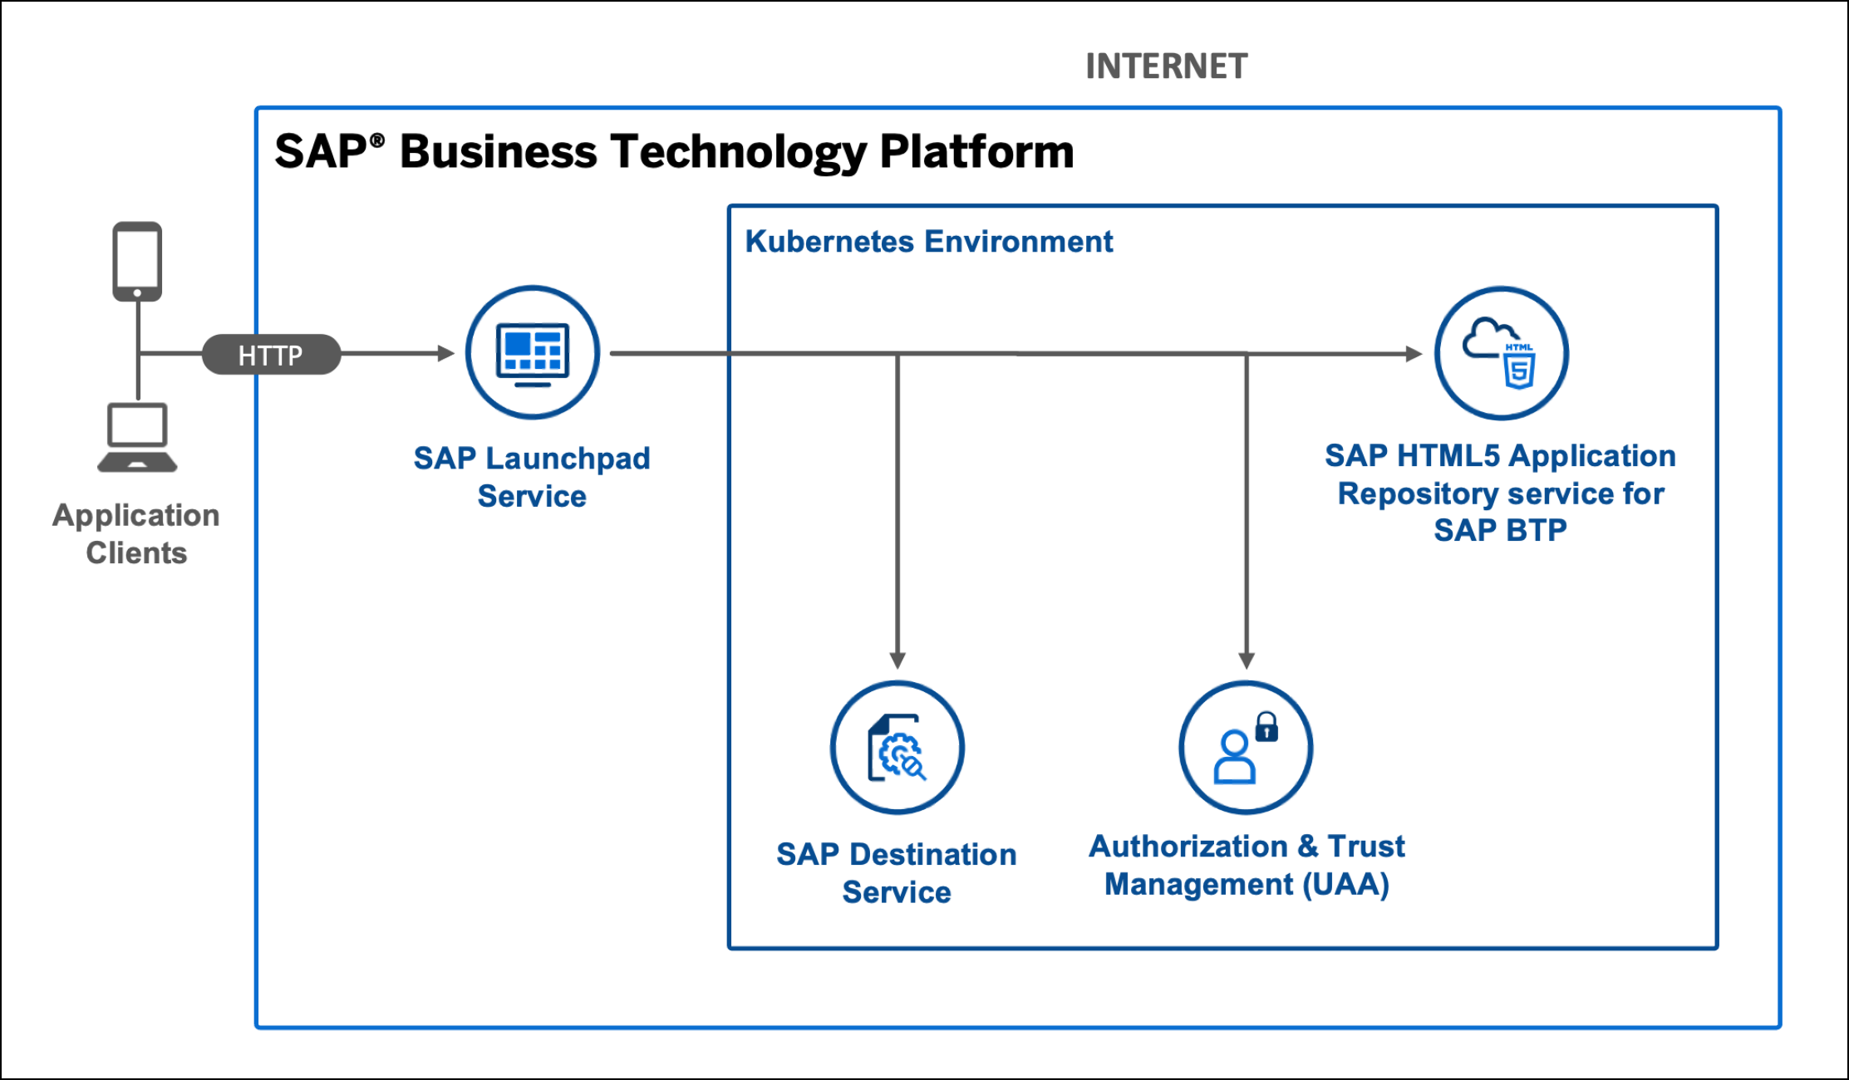
Serverless Fiori App

Slide 6
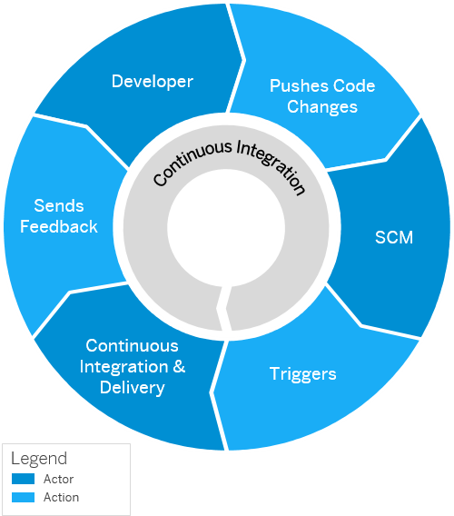
Continuous Integration and Delivery (CI/CD)
Configure and run predefined continuous integration and delivery (CI/CD) pipelines that automatically build, test, and deploy your code changes to speed up your development and delivery cycles.
Continuous integration (CI) describes a software development process, in which various team members integrate their contributions frequently into a single main line. Before each integration, the changes are verified through builds and automated testing. Thereby, you can detect errors as quickly as possible and prevent integration problems before completing the development.
The continuous delivery (CD) concept expands on the one of continuous integration. It adds the aspect that any change that has successfully passed the tests is immediately ready to be deployed to production, both from a technical and a qualitative point of view.

Slide 7
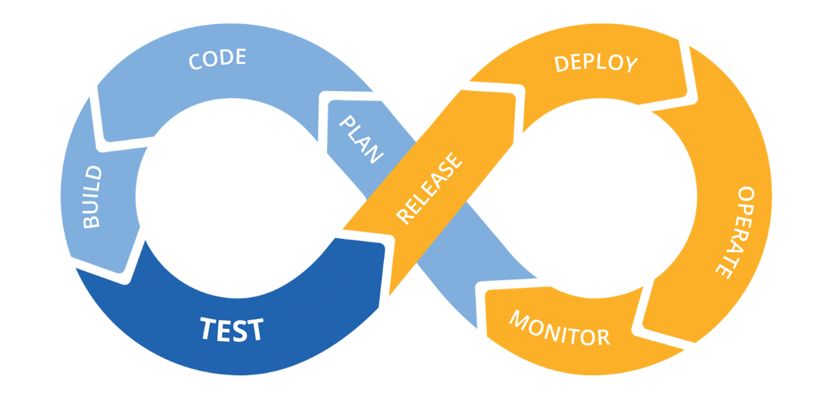
Hands on: Continuous Integration

Slide 8
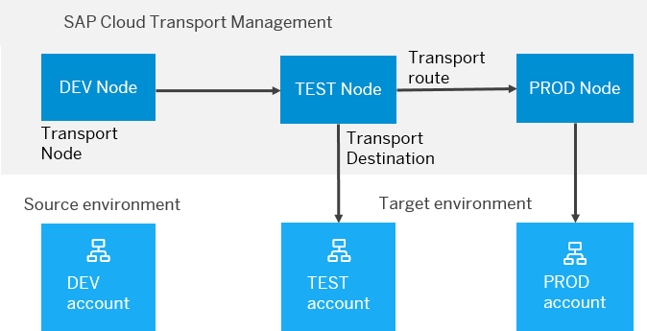
BTP Cloud Transport Management
SAP Cloud Transport Management service lets you manage software deliverables between accounts of different environments (such as Neo and Cloud Foundry), by transporting them across various runtimes. This includes application artifacts as well as their respective application-specific content.
SAP Cloud Transport Management service adds transparency to the audit trail of changes so that you get information about who performed which changes in your production environment, and when they did it. At the same time, the service enables a separation of concerns: For example, a developer of an application or of SAP Cloud content artifacts can trigger the transport of changes in a development subaccount, while the resulting import into the test, and production subaccount is handled by a central operations team.

Slide 9

Hands on SAP BTP Cloud Transport

Slide 12

What We Did
Let’s Summarize

Slide 13

www.anubhavtrainings.com
Thank You
End of Day 6

Slide 14


We’re committed to empower you to be
#FutureReady
through powerful training solutions.
We build the workforce of the future.
260+
Corporate Clients
60,000+
Learners Trained
26000+
Learners Placed
FREE WEBINARS
Sign up for free webinars with industry experts every fortnight!
Enroll Now!
Contact us today!
https://anubhavtrainings.com

